Slide 1
Singapore
Green Plan 2030

Slide 2
GREEN PLAN PILLARS
City in Nature (Tze Hsuen)
Energy Reset (Teagan)
Integrating greenery into our ever-growing urban spaces
Sustainable energy consumption
Sustainable Living (Sheh Nee)
Resilient Future (Cheng Hock)
Reduce, reuse, recycle
Strengthening our food security
Notes:
Sets of goals allig

Slide 3
Table of contents
01.
Target Audience
04.
Sub-Hypothesis Statement
02.
Survey Analysis
05.
Datasets
03.
Interviews
06.
Planned Timeline

Slide 4
01
Target Audience

Slide 5
TARGET AUDIENCE
Citizens who have lived in Singapore for more than 10 years
Incorporate valued experience as insights in responses

Slide 6
NEWS ARTICLES QUOTE
“It will influence all aspects of our lives, from how we live to how we work and play, as we work together as a nation to make Singapore a greener and more livable home.”
“I hope Green Plan will catalyse a broader national movement to take action to secure a sustainable future for Singapore. With each of us playing or part, I have every confidence that we will be able to build a more vibrant and greener home for future generations”
Five ministers involved in Green Plan 2030
https://www.straitstimes.com/singapore/environment/singapore-green-plan-2030-to-change-the-way-people-live-work-study-and-play
Deputy Prime Minister Heng Swee Keat
Singapore unveils Green Plan 2030, outlines green targets for next 10 years - CNA (channelnewsasia.com)

Slide 7
02
Survey Analysis

Slide 8
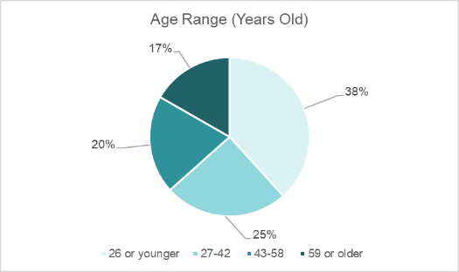
Age
SURVEY ANALYSIS
Survey Respondent Profile
Varied age profile allows for wider set of views

Slide 9
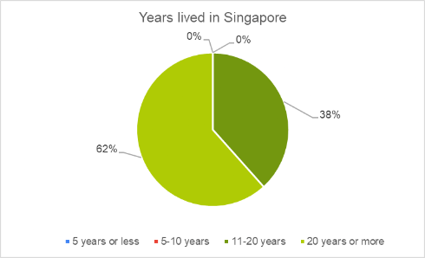
Years of Residence
SURVEY ANALYSIS
Survey Respondent Profile
> 10 years allows for valued insights and opinions

Slide 10
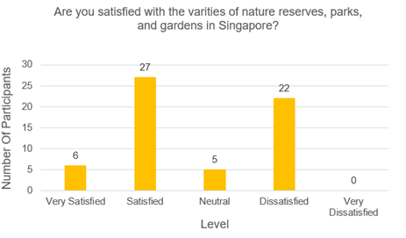
SURVEY ANALYSIS
City in Nature
55% of the respondents were content with the diversity of green spaces in Singapore
37% of them expressed dissatisfaction, suggesting a perception of limited green spaces
8% of them had neutral feelings, signifying neither satisfied nor dissatisfied with the varieties of green spaces

Slide 11
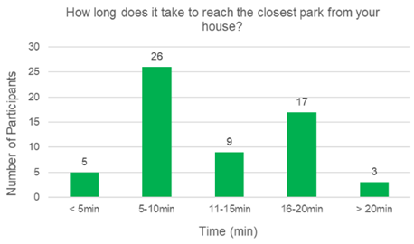
SURVEY ANALYSIS
City in Nature
31 respondents reside within 10-minute walking distance from their house to a park.
5 of them took less than 5 minutes, while 26 of them took 5 to 10 minutes to reach
29 of the respondents took over 10 minutes to get to their nearest park
9 of them took around 11 to 15 minutes, 5 of them took around 16 to 20 minutes, and 3 of them took more than 20 minutes to reach

Slide 12
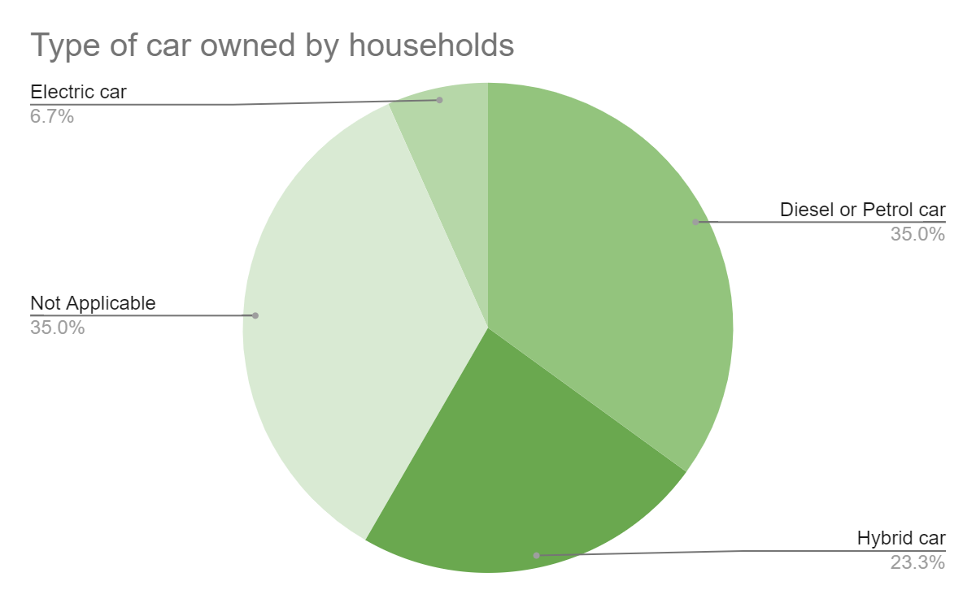
SURVEY ANALYSIS
Energy Reset
21 (35%) of Singaporeans do not have a car. This might be because of the recent increase of Certification of Entitlement (COE). 4 (6.7%) and 14 (23.3%) have an electric car and hybrid car respectively
This might be because they are aware that hybrid or electric cars are more sustainable

Slide 13
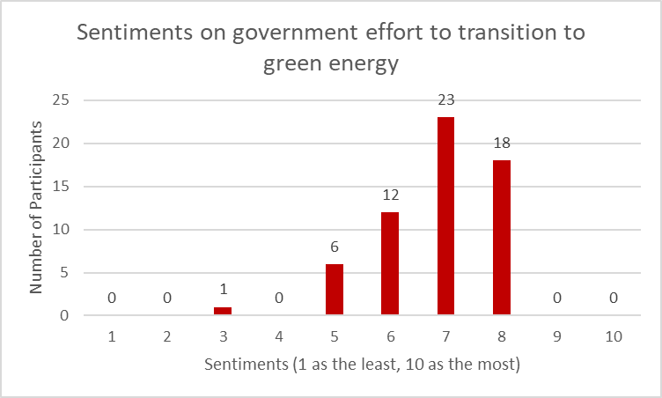
SURVEY ANALYSIS
Energy Reset
53(~89%) respondents feel that the government is putting effort (scale >5) to transition to green energy
This could be due to Singaporeans being knowledgeable about government efforts

Slide 14
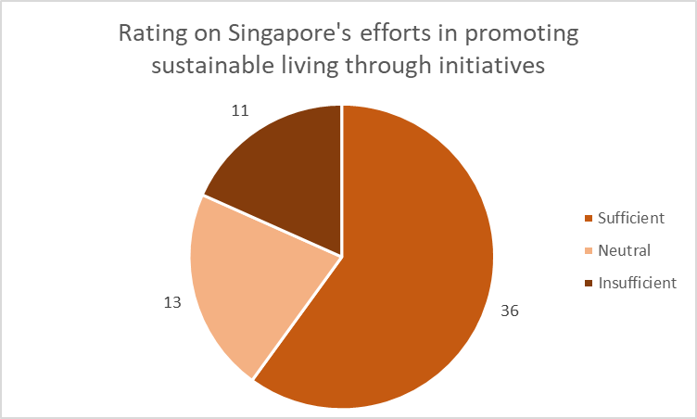
SURVEY ANALYSIS
Sustainable Living
60% of respondents expressed the view that Singapore’s efforts in promoting sustainable living are sufficient
18.3% of the respondents believe these efforts are insufficient
The remaining 21.7% maintain a neutral stance on the efforts of Singapore in fostering sustainable living

Slide 15
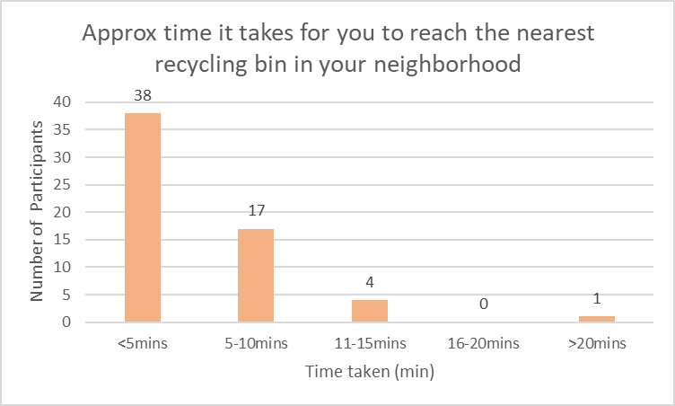
SURVEY ANALYSIS
Sustainable Living
Most of the respondents (38) take less than a 5-minute walk to reach the nearest recycling bin in their neighbourhoods
Some of the respondents (17) take 5 to 10 minutes
Minority of the respondents (5) take more than 10 minutes

Slide 16
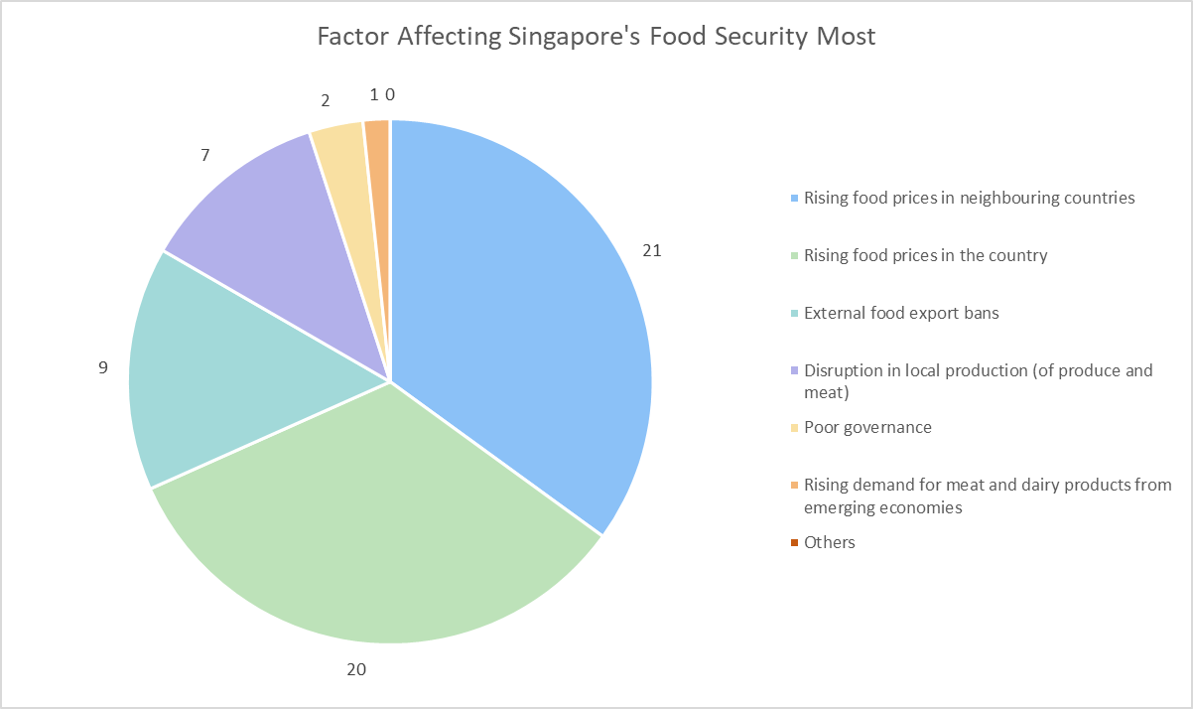
SURVEY ANALYSIS
Resilient Future
Rising food prices in neighbouring countries is most prominent factor (35%)
Singapore’s food prices volatile to shifts accordingly to global food prices, causing food to be inaccessible
Rising demand for meat & dairy products from emerging economies is the least of the worries (~0.016%)
With high purchasing power, thus not prone to food relocation

Slide 17
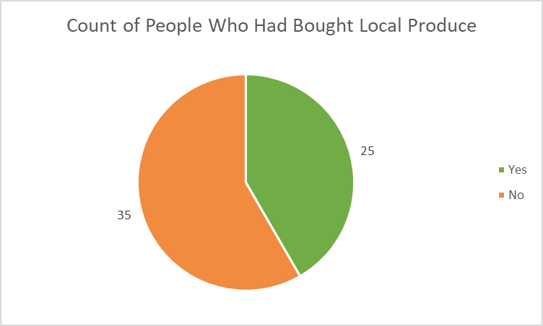
SURVEY ANALYSIS
Resilient Future
~58% of the respondents have never bought locally grown produce
This could be due to the higher price points of locally grown produce as compared to imported ones

Slide 18
03
Interview

Slide 19

INTERVIEW
8 interviewees
More than 10 years of residence in Singapore

Slide 20

EXPERT INTERVIEW
Third party to validate our solutions
Analyse where solutions fits the problem comprehensively
Explored caveats of our solutions
Suggested areas where we can introduce our solution
Prof. from NUS
Deputy Head, School of Design and Environment

Slide 21
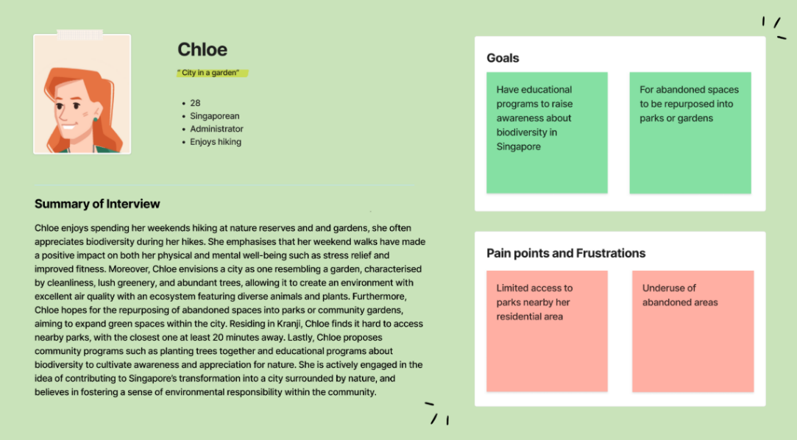
PERSONA – CHLOE
City in Nature

Slide 22
PERSONA – CHLOE
Pain points
Area of concern
City in Nature
Limited access to parks nearby her residential area
Underuse of abandoned areas
Insufficient green spaces in Singapore

Slide 23
PERSONA – CHLOE
Area of concern: Insufficient green spaces in Singapore
Solution: Increase integration of greenery in urban and residential area
Benefits:
Increase the number of nature parks and gardens
More lush greenery in working spaces
Utilise rooftop spaces
Cons:
High maintenance cost
City in Nature

Slide 24
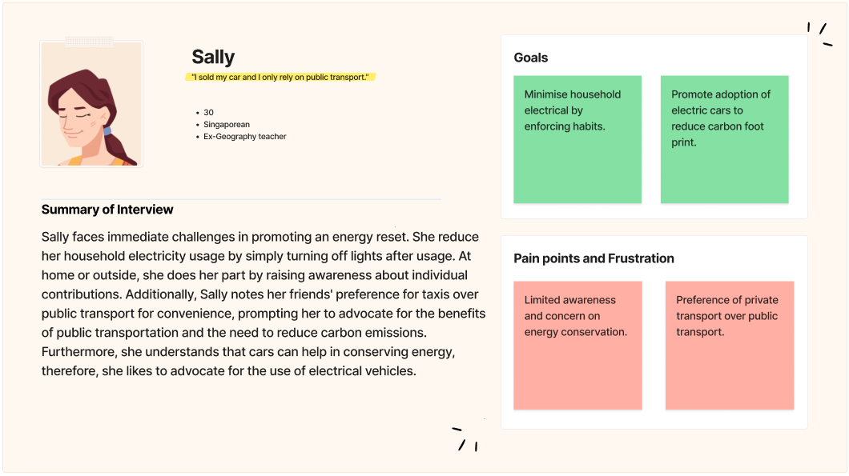
PERSONA – SALLY
Energy Reset

Slide 25
PERSONA – SALLY
Pain points
Area of concern
Energy Reset
Limited awareness and concern on energy conservation
Friends preference of private transport over public transport
Lack of care of energy conservation methods within singaporeans

Slide 26
PERSONA – SALLY
Area of concern: Lack of care of energy conservation methods within singaporeans
Solution: Establish incentives and penalties to promote conservation methods
Benefits:
Encourage citizens to adopt energy conservation habits
Promote ridership on public transportations
Cons:
Challenging for the public to adopt
Energy Reset

Slide 27
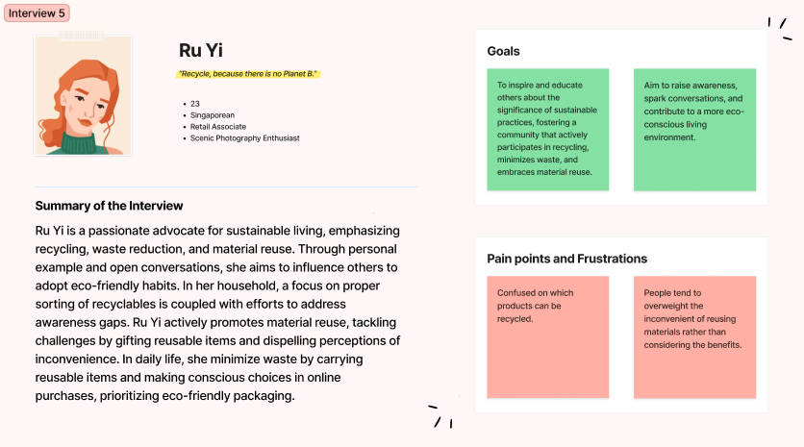
PERSONA – RU YI
Sustainable Living

Slide 28
PERSONA – RU YI
Pain points
Area of concern
Sustainable Living
Confused on which products can be recycled
People tend to overweight the inconvenient of reusing materials rather than considering the benefits
Limited awareness in eco-friendly practices

Slide 29
PERSONA – RU YI
Area of concern: Limited awareness in eco-friendly practices
Solution: Implement widespread eco-friendly education campaigns and workshops
Benefits:
Foster a green mindset
Promote eco-friendly habits
Cons:
High initial costs of campaigns and workshops
Potential resistance to change (habits)
Requires skilled workforce
Sustainable Living

Slide 30
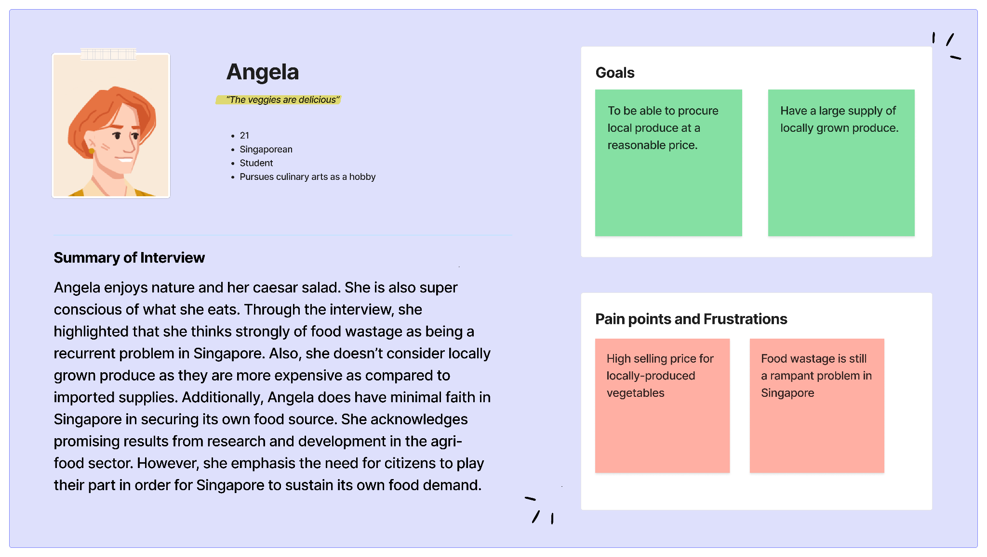
PERSONA – ANGELA
Resilient Future

Slide 31
PERSONA – ANGELA
Pain points
Area of concern
Resilient Future
High selling price for locally-produced vegetables
Food wastage rampant in country
Singapore will not be able to sustain its food demand in the future.

Slide 32
PERSONA – ANGELA
Area of concern: Singapore will not be able to sustain its food demand in the future.
Solution: Increase local food production
Benefits:
Increase in skilled workforce
Funds and grants to invest in agri-food R&D
Cons:
Limited land mass, consequently restricted food production
Resilient Future

Slide 33
USER STORIES
City in Nature | Interview 1
Energy Reset | interview 3
As a citizen, I want to have access to nearby parks within my residential area, so that I can easily incorporate short walks into my daily routine.
As a citizen, I want to encourage more landed residents to install solar panels, so that I can help others play their part in using renewable energy at home.
Sustainable Living | Interview 5
Resilient Future | Interview 7
As an eco-advocate, I want to lead by example in promoting recycling, using reusable items, and proper waste disposal, so that I can inspire others about sustainable living.
As a culinary hobbyist, I want to purchase locally grown produce at a lower price, so that I can support local farms in the long run.
Notes:
Sets of goals allig

Slide 34
04
Sub-Hypothesis Statement

Slide 35
SUB-HYPOTHESIS STATEMENT
City in Nature
Energy Reset
The City in Nature pillar of the Green Plan is committed to expanding urban greenery, aligning with Singapore’s goal of sustainable living.
The Energy Reset pillar of the Green Plan is committed to making energy consumption better holistically.
Sustainable Living
Resilient Future
The Sustainable Living pillar of the Green Plan is committed to building an eco-friendly country.
The Resilient Future pillar of the Green Plan is committed to making its food supply resilient in the future.
Notes:
Sets of goals allig

Slide 36
05
Datasets & Resources

Slide 37







TOOLS USED
Interview Platforms
Survey Platforms
Display Visuals

Slide 38
DATASETS
City in Nature
Description | Dataset
Tree Cover Loss in Singapore | Singapore Deforestation Rates & Statistics | GFW (globalforestwatch.org)
Annual Carbon Dioxide (CO₂) Emission | https://ourworldindata.org/co2/country/singapore
Total Land Area | (DOS) | SingStat Table Builder – Land Area (As At December)
Total Area of Green Spaces | NParks Annual Report – Archives - Annual Reports - Who We Are - National Parks Board (NParks)
Number of Regional and Neighbourhood Parks | NParks Annual Report – Archives - Annual Reports - Who We Are - National Parks Board (NParks)
Number of Parks per Region | NParks Annual Report – Archives - Annual Reports - Who We Are - National Parks Board (NParks)
Licensed Veterinarians and Veterinary Centres | NParks Annual Report – Archives - Annual Reports - Who We Are - National Parks Board (NParks)

Slide 39
DATASETS
Energy Reset
Description | Dataset
Public Transportation | https://tablebuilder.singstat.gov.sg/table/TS/M651351
New Registration of Cars in 2023 2nd half | https://www.lta.gov.sg/content/dam/ltagov/who_we_are/statistics_and_publications/statistics/pdf/M03-Car_Regn_by_make.pdf
Energy Prices | https://www.ema.gov.sg/resources/singapore-energy-statistics/chapter5
Energy Consumption | https://www.ema.gov.sg/resources/singapore-energy-statistics/chapter3
Solar Energy | https://www.ema.gov.sg/resources/singapore-energy-statistics/chpater6
Annual Vehicle Statistics 2022 | https://www.lta.gov.sg/content/dam/ltagov/who_we_are/statistics_and_publications/statistics/pdf/MVP01-6_Cars_by_make.pdf

Slide 40
DATASETS
Sustainable Living
Description | Dataset
Recycling Waste by Waste Type | https://beta.data.gov.sg/datasets/d_9740df787da2b59a0b5bd76a6c33453d/view
Frequency of recycling single-use plastic bottles | https://www.statista.com/statistics/1389977/singapore-frequency-of-recycling-plastic-bottles/
Volume of Waste Recycled | https://www.statista.com/statistics/628048/waste-recyced-in-singapore/
The Total Volume of Waste Paper generated | https://www.statista.com/statistics/962178/waste-paper-generated-volume-singapore/
Consumers’ Perception towards Food Packaging | https://www.statista.com/statistics/1208386/singapore-perception-towards-food-packaging/

Slide 41
DATASETS
Resilient Future
Description | Dataset
Local Food Production Output Yearly | (DOS) | SingStat Table Builder – Local Production
Local Egg Production Quarterly | SFA | Annual Food Reports
Licensed Local Food Farms Yearly | (DOS) | SingStat Table Builder – Licensed Local Food Farms
Merchandise Imports by Commodity Division Monthly | (DOS) | SingStat Table Builder – Merchandise Imports By Commodity Division
Agricultural-orientation Index Yearly | The Agriculture Orientation Index for Government Expenditure
Food Wastage and Recycled Yearly | NEA | Food Waste Management

Slide 42
06
Planned Timeline

Slide 43
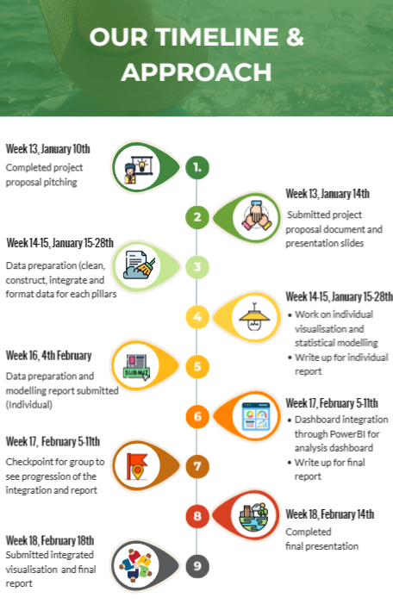
PLANNED TIMELINE

Slide 44
THANK YOU !

